Slide 1


WoW Technical Deliverable (3rd Tech Talk)
Effective Platform: Market Area North America (MANA) Platform
Topic of discussion: LDAP configuration with Grafana
JIRA Ticket Reference: MC-494 & MC-495
Date of Presenting: 20th August 2019
Presenter: Ankita Adhya (EANKADH)

Slide 2

PROBLEM STATEMENT
Grafana user creation – a redundant task. Also, general credential is less secured!
What is affected?
Occurring where?
Previous Scenario
Workaround Implemented
Operations Team has to create each users explicitly for authentication in Grafana.
While logging into the Grafana Server to view Grafana Dashboards!
AO Team has to explicitly create each user at Grafana Server for authentication
Team monitoring from Grafana Dashboard can have generic credentials used!
Workaround to use generic credential is less secured.

Slide 3

SOLUTION DELIVERED/IMPLEMEMTED
Grafana Server can be authenticated for users in many ways.
LDAP integrations is one of them!
LDAP authentication integrations even enables syncing user permissions and organization memberships. LDAP Authentication includes OpenLDAP, ActiveDirectory, etc as solution.
MANA Grafana Dashboards have been enabled now with the LDAP Authentication which reduces the effort to create new user at Grafana Server for login and authentication for onboarding each and every user to Grafana Dashboards. Also, each user have their own credentials which gets authenticated while logging in!

Slide 4

RUDIMENTS OF THE SOLUTION IMPLEMENTED
Grafana must be installed and configured at grafana.ini configuration file.
Grafana environment must be set at /etc/sysconfig/grafana-server file.
Grafana service should be up and running.
IPA(Open Source Redhat IdM/Identity Management System) must be installed and configured.
Nodes of the cluster must be installed with ipa-client.
All identities of user stored and maintained in IPA Server.

Slide 5

ENACTMENT FOOTSTEPS
LDAP first needs to be turned on in main Grafana configuration file as well as the path to LDAP specific configuration file needs to be specified
Enable LDAP in the main Grafana configuration file-
[root@butters48 ~]# cd /opt/mapr/grafana/grafana-4.6.1/etc/grafana/
[root@butters48 grafana]# vi grafana.ini
~ Uncomment the allow_org_create property and set it to true-
------------- line 181 ---------------------
# Allow non admin users to create organizations
allow_org_create = true
~ Uncomment the LDAP authentication and enable it-
------------- line 280 ----------------------
######################### Auth LDAP ###################
[auth.ldap]
enabled = true
config_file = /opt/mapr/grafana/grafana-4.6.1/etc/grafana/ldap.toml
allow_sign_up = true

Slide 6
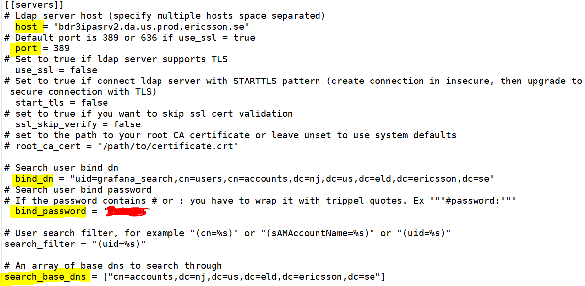

CONFIGURING LDAP PARTICULARS
Grafana LDAP Configuration:
Depending on which LDAP server used and how that’s configured Grafana LDAP configuration may vary. The configuration done in MANA Cluster is as follows:
~ A backup of original ldap.toml file is first kept-
[root@butters48 grafana]# cp ldap.toml ldap_bkp.toml
~ Following changes done in ldap.toml file: (as on Snip)

Slide 7
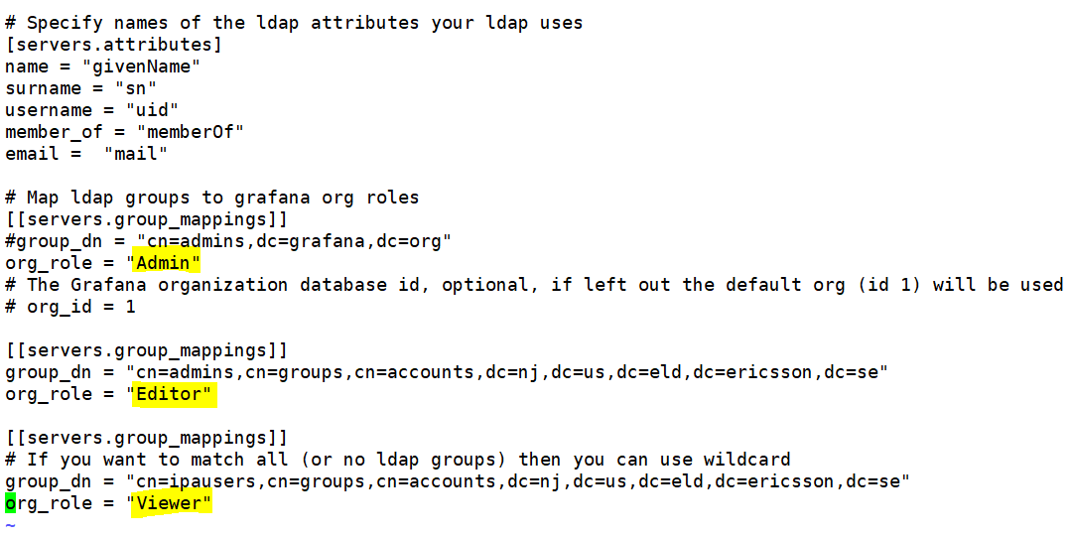

PERMISSIONS AND ORGANIZATION ROLES
Users can be belong to one or more organizations. A user’s organization membership is tied to a role that defines what the user is allowed to do in that organization. Based on users’ permissions and roles, required changes needs to be done at ldap.toml file:

Slide 8
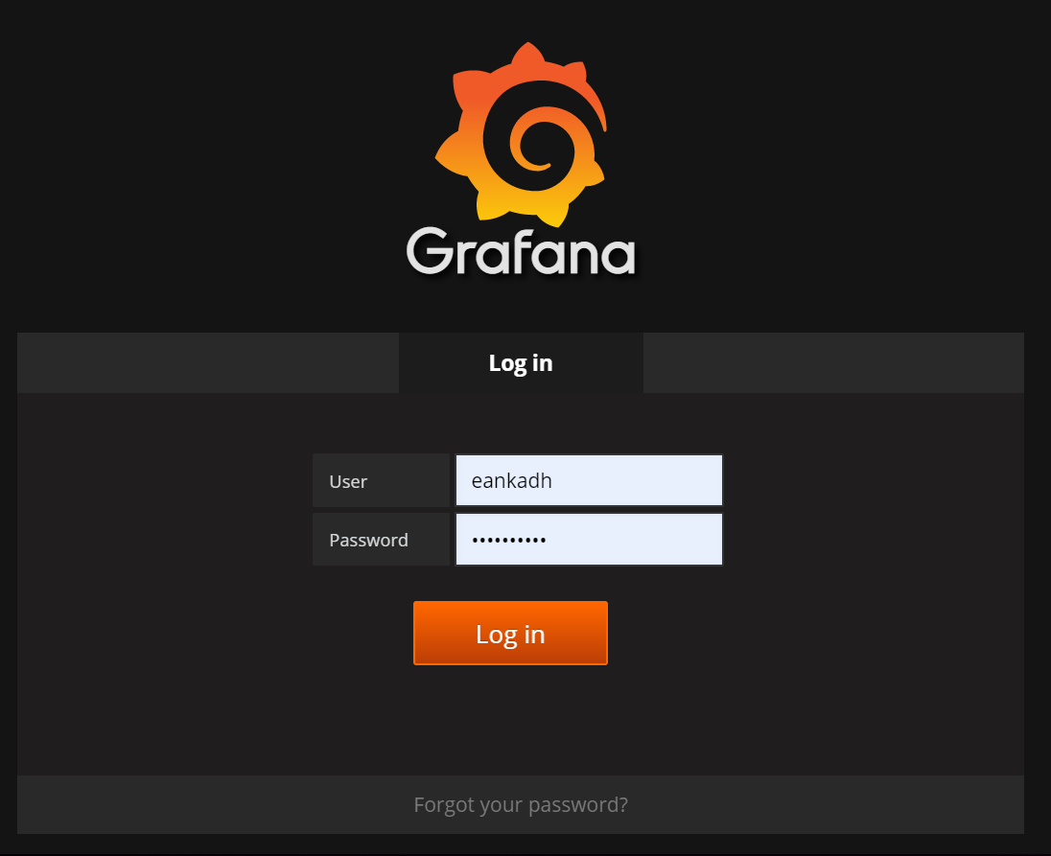
GRAFANA SERVER & REFERENCES
MANA Production Grafana Server URL- http://butters48.da.us.prod.ericsson.se:3000/login
Reference Link:
https://grafana.com/docs/v4.6/installation/ldap/

Slide 9



BENEFITS OF THE SOLUTION
Benefit 1
Platform Support Team no longer need to onboard each user on Grafana server/dashboards. No extra effort required for user authentication now on in Grafana Server.
Benefit 2
User need not require to use any generic/common credentials to login to the Grafana Server which was less secured. LDAP Authentication is now used.
Benefit 3
Platform Support Team need not explicitly set the permissions and roles of the user who has been onboarded to the Grafana Server.

Slide 10


